Slide 1
CiviCRM
Lecturer: Ngo Huy Bien
Software Engineering Department
Faculty of Information Technology
VNUHCM - University of Science
Ho Chi Minh City, Vietnam
nhbien@fit.hcmus.edu.vn

Slide 2

Objectives
To learn CiviCRM by yourself.

Slide 3

Contents

Slide 4

References

Slide 5


We Need a Problem First!

Slide 6
Example Needs
Replace Salesforce Cases by a cheaper solution.
Install and configure CiviCRM instance.

Slide 7


Slide 8
1. Find Appropriate Documentation
https://civicrm.org/download
https://docs.civicrm.org/installation/en/latest/general/requirements/
https://docs.civicrm.org/installation/en/latest/wordpress/

Slide 9
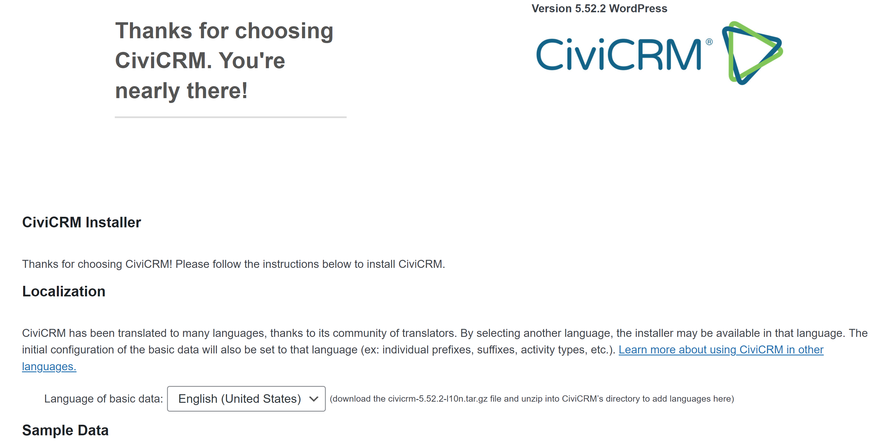
2. Install CiviCRM
Use default option first.

Slide 10
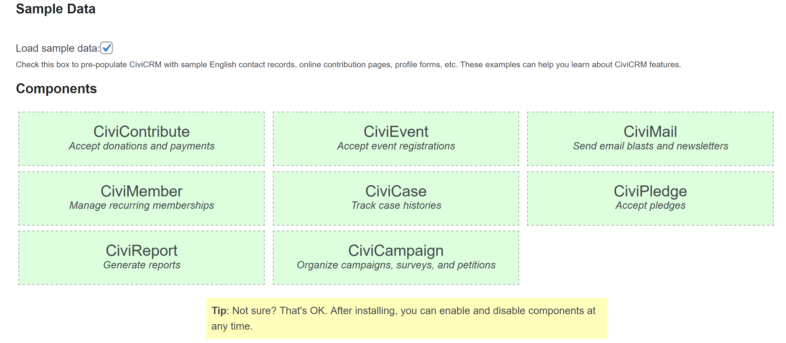
3. Select Components

Slide 11
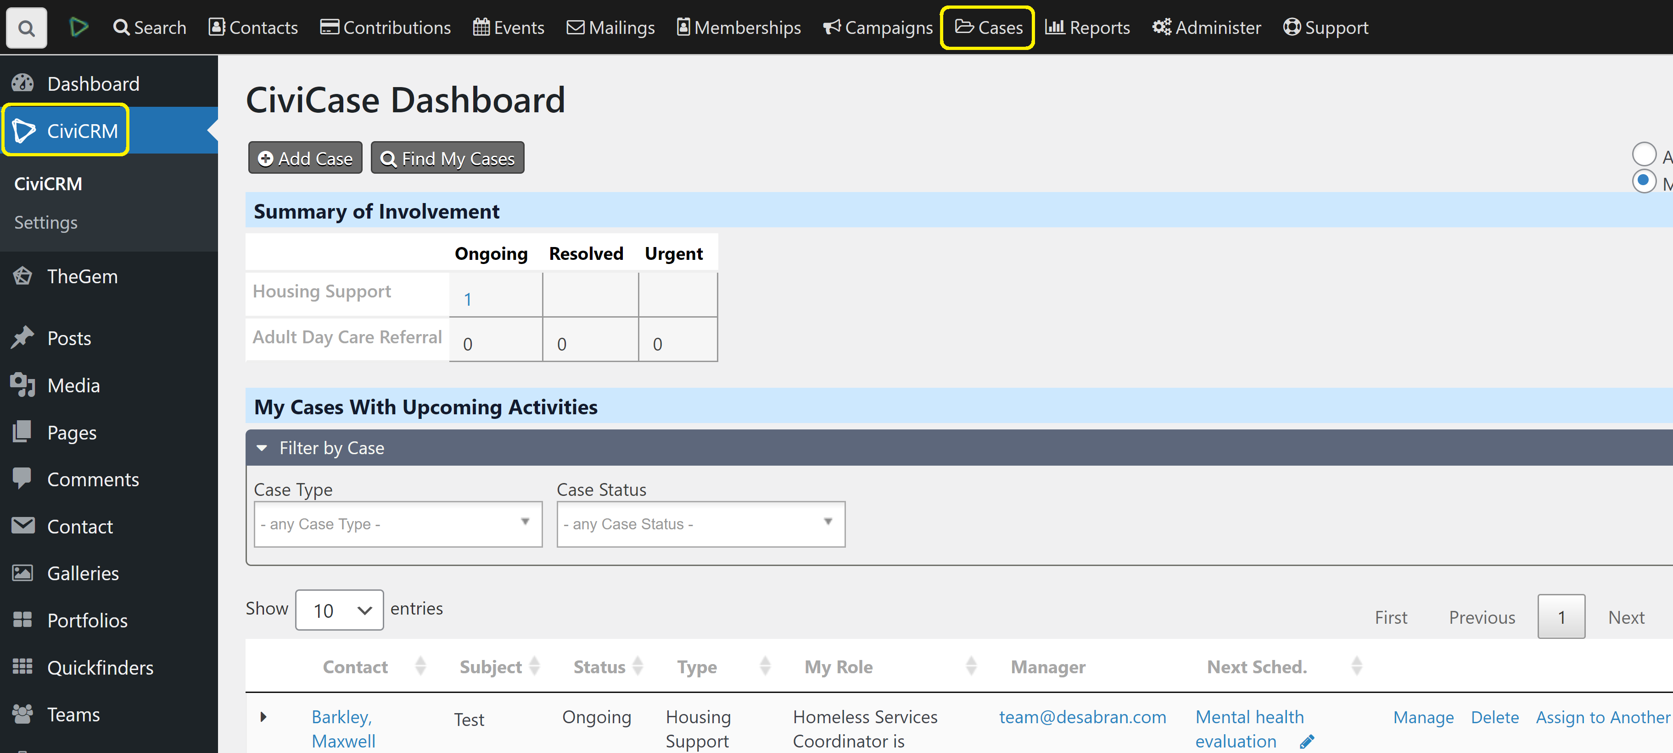
4. Review Features
https://docs.civicrm.org/user/en/latest/organising-your-data/mapping-your-data/

Slide 12

Thank You & See You Again

